Slide 1
MySQL Installation

Slide 2


MySQL

Slide 3
MySQL
What is MySQL?
MySQL is a relational database management system used to store and manage data.
How to Install
Go to the official MySQL website: MySQL Downloads.
Choose the appropriate MySQL Community Server version for your operating system.
Download the installer.
Run the installer and follow the installation instructions. You'll set a root password during the installation process

Slide 4
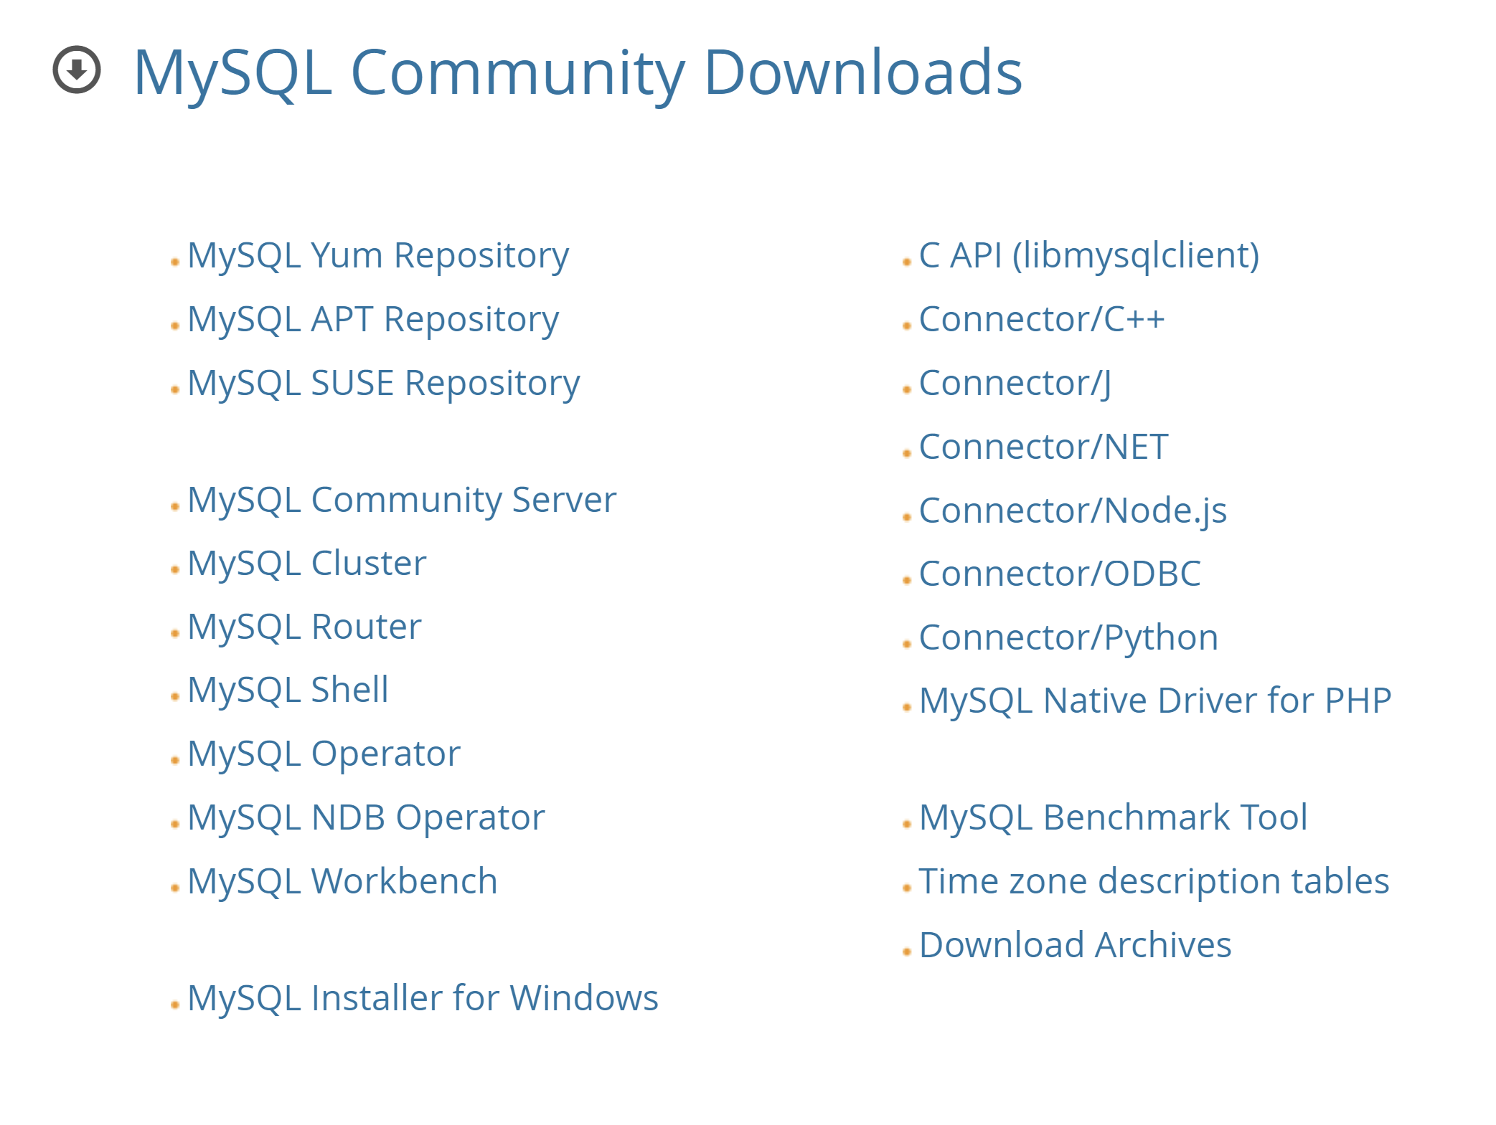
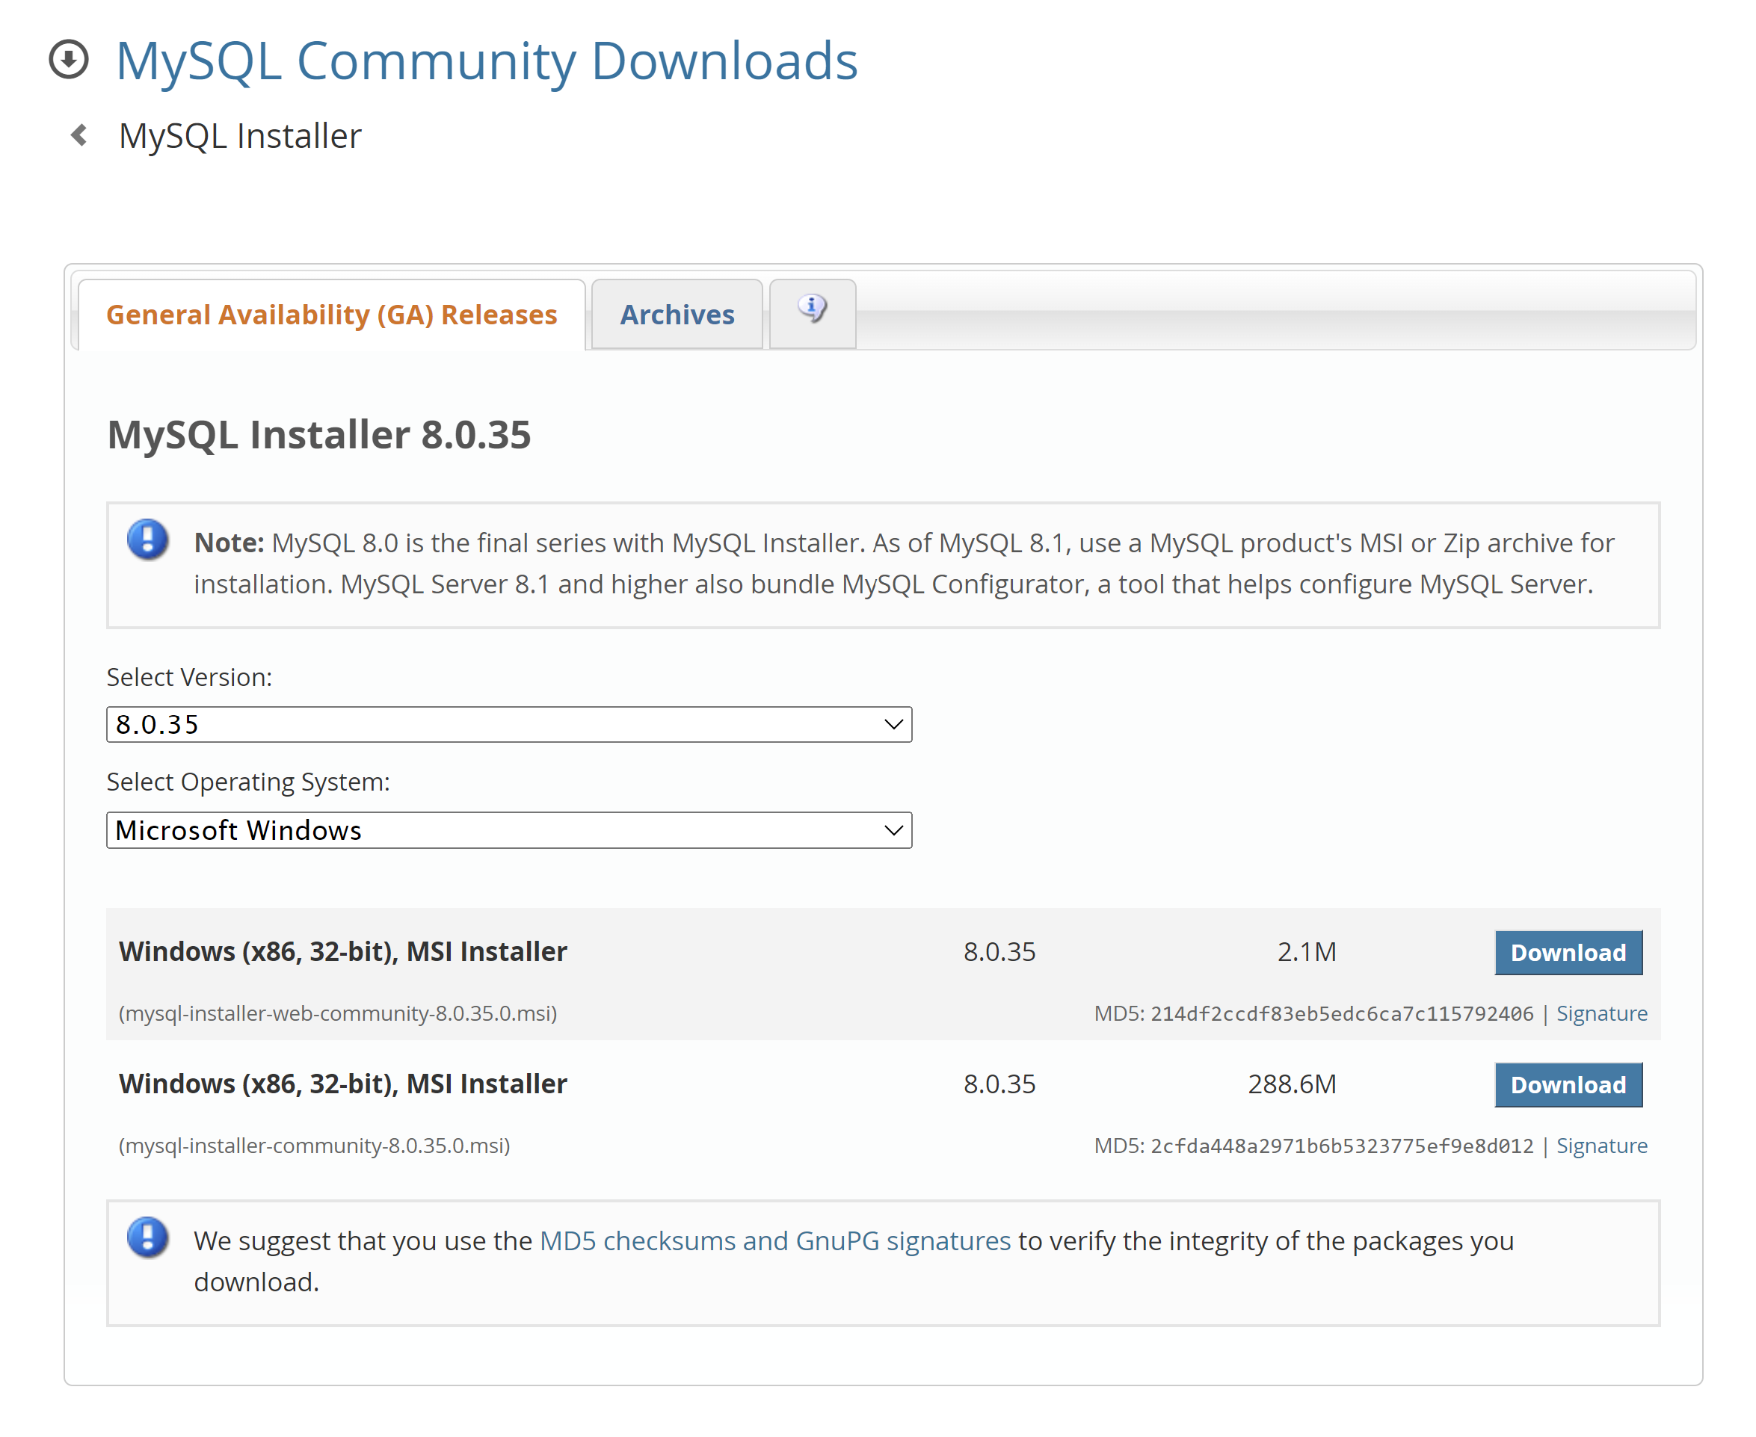
Cont…

Slide 5
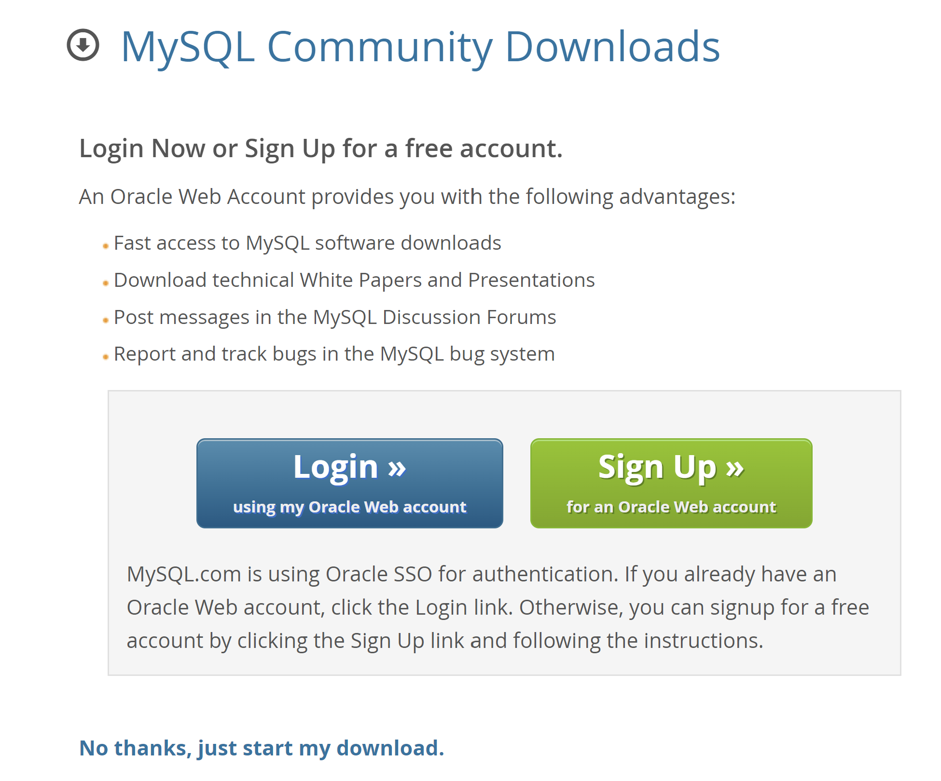
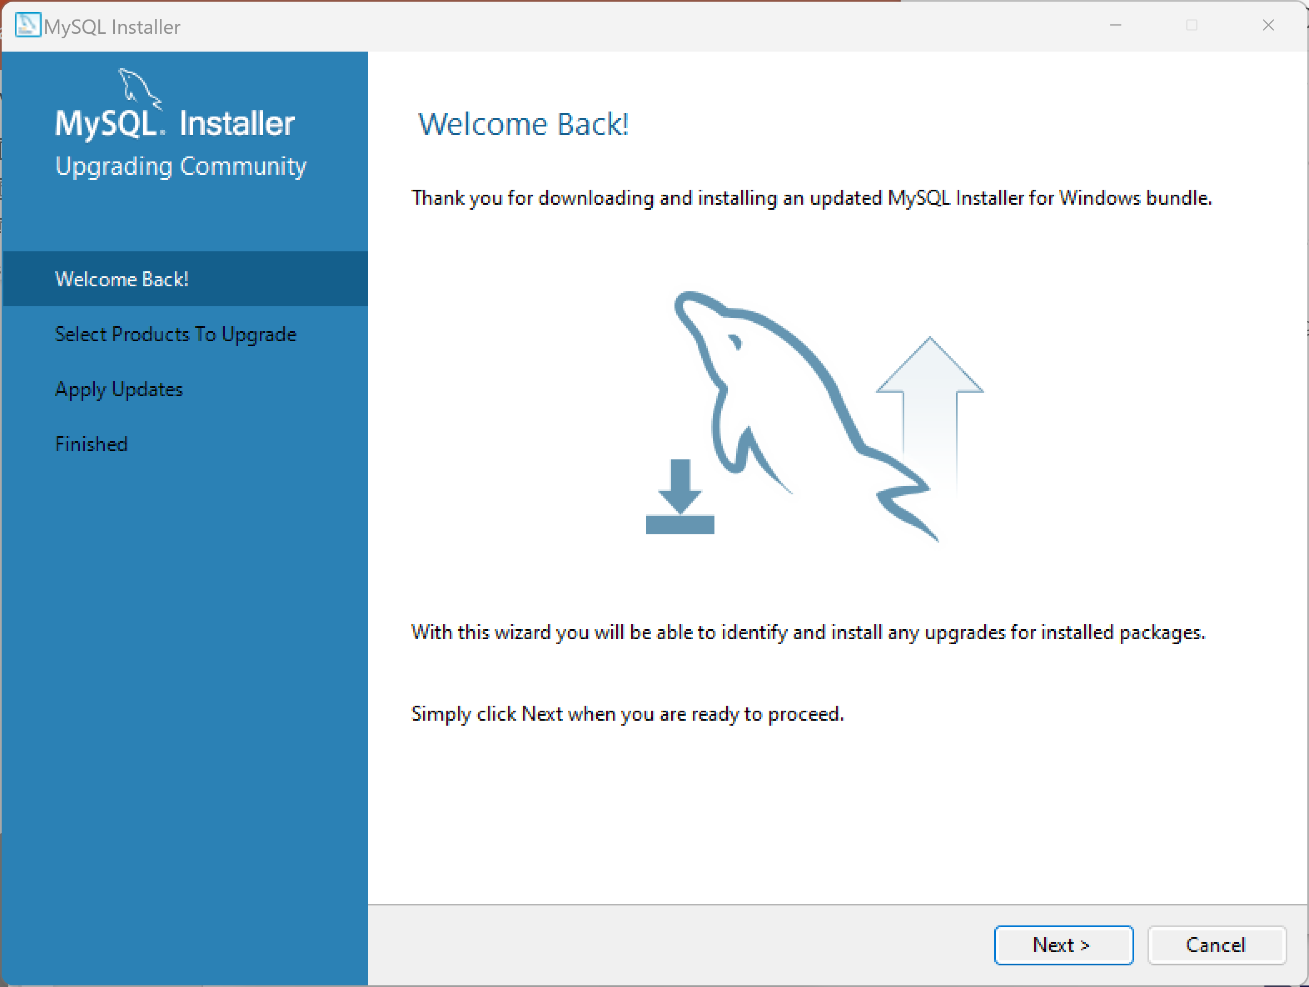
Cont…

Slide 6
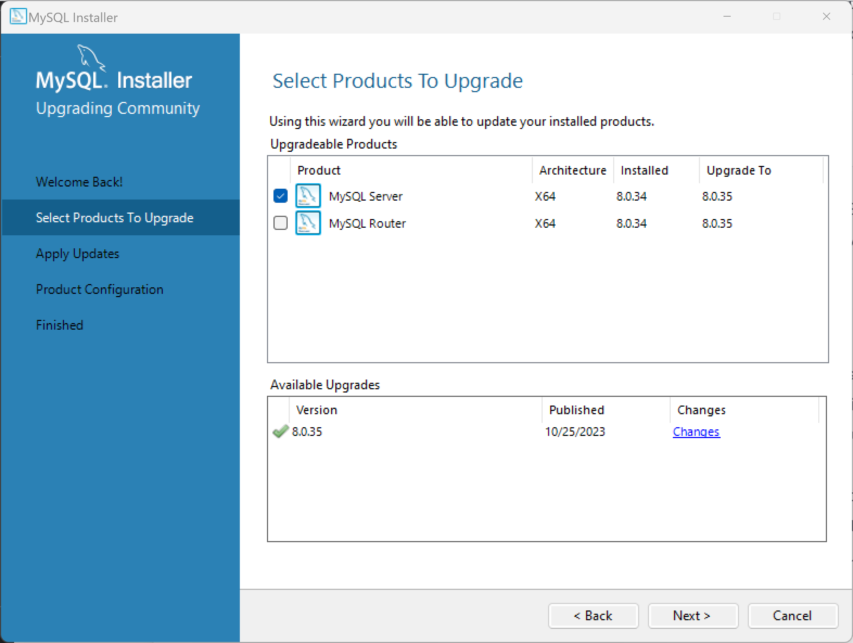
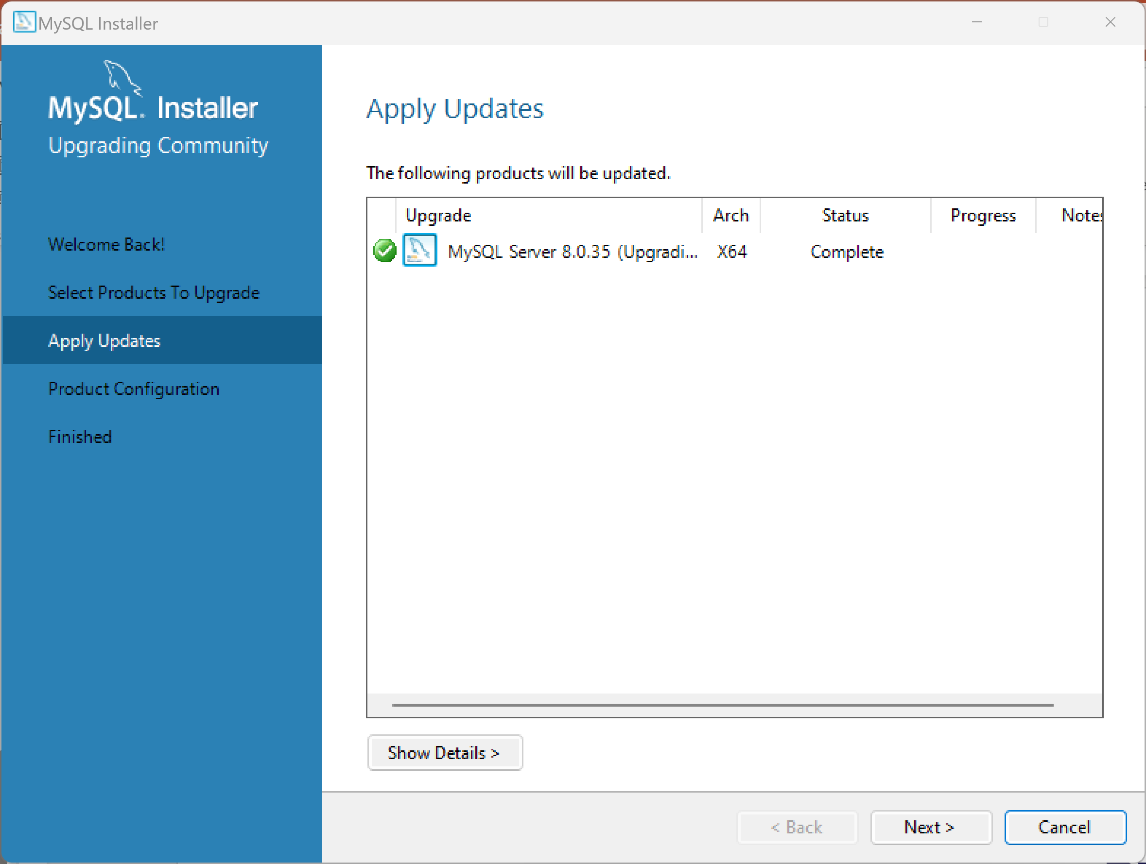
Cont…

Slide 7
Thank You

